Slide 1
FRONTEND ENGINEERING-I
(24CSE0102)
Dr. Chetna Shamra
Department of Computer Science and Engineering,
Chitkara University, Punjab

Slide 2
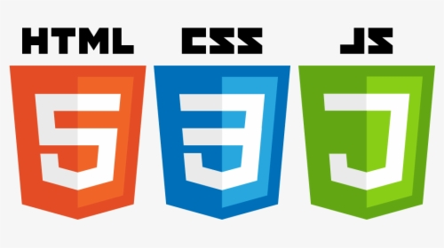
INTRODUCTION TO WEB TECHNOLOGIES

Slide 3
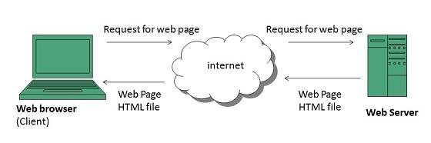
Web Application
What can we do on web?
We rely on different websites/web apps for different tasks.
Submitting online application
Banking transactions
Purchasing of goods
Watching movies .etc
A web page contain texts, images, graphics, sounds animations etc.
Web pages are developed in HTML

Slide 4
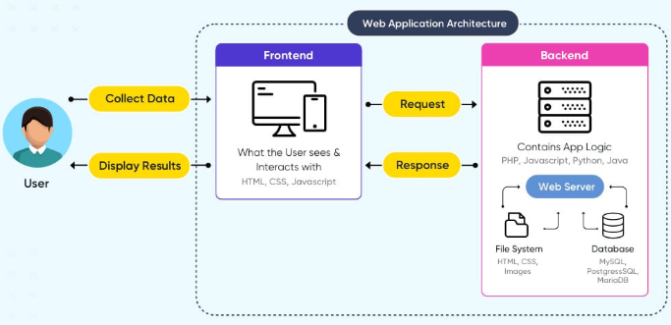
Web Application Architecture

Slide 5
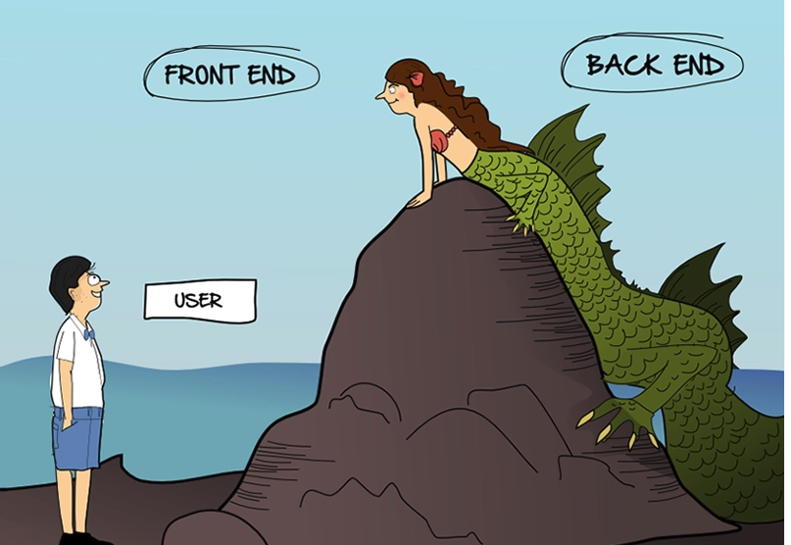

Slide 6
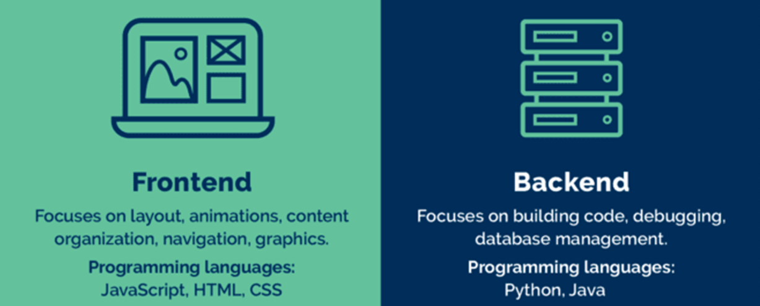
Front End vs Back End
Front End vs Back End
Front end development is programming which focuses on the visual elements used to see on client side
Back-end ensure the website performs correctly, focusing on organization of data, logic, application programming interface (APIs)

Slide 7


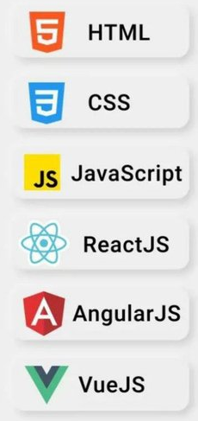
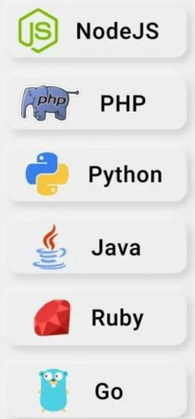
Technologies

Slide 8
Internet and Web (WWW)
Internet and Web(WWW)
Internet:- A global computer network and it is a collection of computers and devices connected via communication channels and transmission media allow to share resources (hardware, software, data, information).
WWW(World Wide Web) –It is a repository of interlinked hypertext documents(web pages) and other resources files that can be accessed via the internet.
These web resources are identified by Uniform Resource Locators (URLs).
URL is the address of a given unique resource on the Web
Ex. https://www.chitkara.edu.in/
Here login.html is a web resource(webpage)

Slide 9
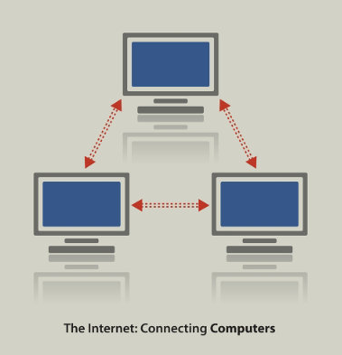
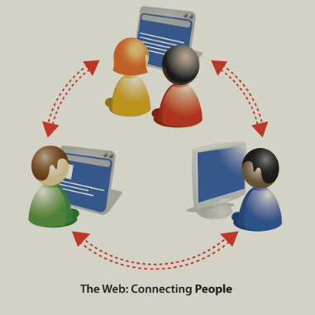
Difference between Internet and WWW
Difference between Internet and World Wide Web
Internet | WWW
 | It is a repository of Common resoucres
Nature of Internet is hardware. | Nature of www is software.
Internet consists of computers, routers, cables, bridges, servers, cellular towers, satellites etc | www consists of information like text, images, audio, video
Internet works on the basis of Internet Protocol (IP) | WWW works on the basis of Hyper Text Transfer Protocol (HTTP)
Computing devices are identified by IP Addresses | Information pieces are identified by Uniform Resource Locator (URL)
It is a network of network
Network connecting
computers
Connects
users/ resources
over internet

Slide 10

Browser and URLs
Browser:
A browser is a program that allows us to view and explore information on the web . A software application for retrieving, presenting, and traversing information resources on the World Wide Web.
Web browser can show text, audio, video, animation and more. It is the responsibility of a web browser to interpret text and commands contained in the web page.
User can request for any web page by just entering a URL into address bar
Uniform Resource Locators, or URLs:
A Uniform Resource Locator, or URL is the address of a document/ web page found on the WWW.
Ex. http://www.google.com/login.html
URL contains 1) Protocol 2) Domain 3)Content/filename/pathname
Domain Name

Slide 11
Protocols and Domain names
1) Protocol: A protocol that is used to transfer pages on the web.
HTTP: Hypertext protocol: http://www.aucegypt.edu
FTP: File Transfer Protocol: ftp://ftp.dartmouth.edu
2) Domain It is a unique reference that identifies a website
It divide World Wide Web sites into categories based on the nature of their owner, and they form part of a site's address, or uniform resource locator (URL).
Common top- level domains are:
Domain - desc | Domain -desc
.com—commercial enterprises | .mil—military site
.org—organization site (non-profits, etc.) | .int—organizations established by international treaty
.net—network | .biz—commercial and personal
.edu—educational site (universities, schools, etc.) | .info—commercial and personal
.gov—government organizations | .name—personal sites
Each country linked to the Web has a two- letter top- level domain,
for example .fr is France, .ie is Ireland.
3) File name or path name: The name of the document file requested.

Slide 12
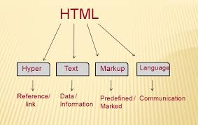
Hypertext Markup Language (HTML)
HTML
HTML stands for Hyper Text Markup Language
HTML is used to create web pages.
HTML is a format that tells a browser how to display a web page.
An HTML file is a text file containing small markup tags
HTML documents are plain text files with special "tags" or codes that a web browser uses to interpret and display information on web browser.
An HTML file must have an .htm or .html file extension.

Slide 13
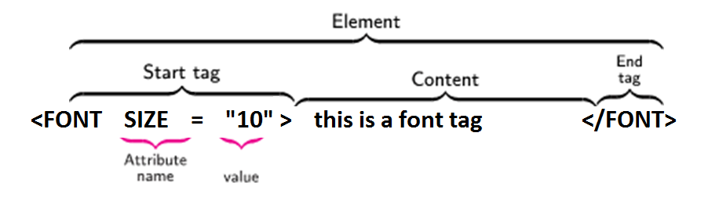
Anatomy of an HTML Element
Anatomy of an HTML element or HTML Tags/Element structure:-
HTML tag:
An HTML tag is surrounded by the two characters < and >.
The surrounding characters are called angle brackets. Ex. <html>
HTML Element:
Come in pair in which first tag is the <start tag>, the second tag is the </end tag>.
The text between the start and end tags is the element content .
Attribute: An attribute in HTML provides extra information about the element, and it is applied within the start tag.
An HTML attribute contains two fields: name & value.
HTML tags are not case sensitive <B>means the same as <b>.

Slide 14
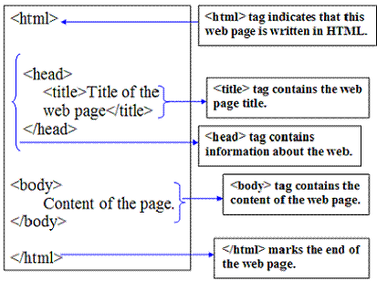
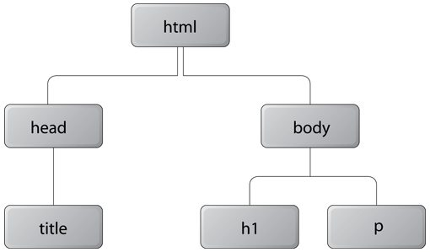
Basic Structure of an HTML document
Basic structure of an HTML document
Fig.Tree Structure of HTML Doc

Slide 15
Tags in HTML – HTML tag
HTML <html> Tag
The <html> tag represents the root of an HTML document.
The <html> tag is the container for all other HTML elements (except for the <!DOCTYPE> tag).
An HTML tag is a piece of markup language used to indicate the beginning and end of an HTML element in an HTML document.
As part of an HTML element, HTML tags help web browsers convert HTML documents into web pages.
<html> HTML Contents... </html>

Slide 16
Tags in HTML
Tags in HTML (… continued)
Program for Displaying Welcome
<html>
<head>
</head>
<body bgcolor="cyan">
welcome to web world
</body>
</html>

Slide 17
Tags in HTML – Head tag
<head> Tag
The <head> element is a container for metadata (data about data) and is placed between the <html> tag and the <body> tag.
Metadata is data about the HTML document. Metadata is not displayed.
Metadata typically define the document title, character set, styles, scripts, and other meta information.
<head> <title>Title of the document</title> </head>
<head> <style> h1 {color:red;} p {color:blue;} </style> </head>

Slide 18
Tags in HTML – Body tag
HTML <body> Tag
The <body> tag defines the document's body.
The <body> element contains all the contents of an HTML document, such as headings, paragraphs, images, hyperlinks, tables, lists, etc.
There can only be one <body> element in an HTML document.
<html> <head> <title>Title of the document</title> </head> <body> <h1>This is a heading</h1> <p>This is a paragraph.</p> </body> </html>

Slide 19
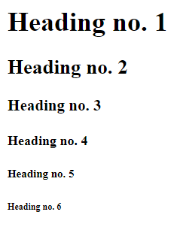
Tags in HTML – Heading tags in HTML
HTML Headings:-
HTML headings are titles or subtitles that you want to display on a webpage.
<h1> is the largest heading tag and
<h6 > is the smallest one
<h1>Heading no. 1</h1>
<h2>Heading no. 2</h2>
<h3>Heading no. 3</h3>
<h4>Heading no. 4</h4>
<h5>Heading no. 5</h5>
<h6>Heading no. 6</h6>

Slide 20
Tags in HTML – Text Level Elements
Displaying Texts and like breaks
Tag | Description
<p> | This tag represents a paragraph.
<h1> to <h6> | Defines header 1 to header 6
<br> | Inserts a single line break
<hr> | Defines a horizontal rule
<!--> | Defines a comment
<p> - Paragraph Tag
The <p> tag defines a paragraph. Browsers automatically add some space (margin) before and after each <p> element..
<p>This is a paragraph</p>
<br> Line Breaks:-
The <br> tag is used when we want to start a new line, but don't want to start a new paragraph.
This Code | output
<p>This <br> is a para<br> graph with line breaks</p> | This is a para graph with line breaks
<hr> The element is used for horizontal rules that act as dividers between sections

Slide 21
Tags in HTML – Text Formatting tags
HTML Text Formatting Elements
HTML Formatting is a process of formatting text for better look and feel.
Element name | Description
<b> | Bold Text
<strong> | This is a logical tag, which tells the browser that the text is important.
<i> | used to make text italic.
<em> | used to display content in italic.
<mark> | This tag is used to highlight text.
<u> | used to underline text written between it.
<strike> | This tag is used to draw a strikethrough on a section of text.
<sup> | -Superscript text.
<sub> | Subscript text.
<del> | This tag is used to display the deleted content.
<ins> | This tag displays the content which is added.
<big> | This tag is used to increase the font size by one conventional unit.
<small> | This tag is used to decrease the font size by one unit from base font size.

Slide 22
Tags in HTML – Text Formatting tags
Adding the spaces between text:
Web page shows only one space between the two words. It does not matter that how much we have pressed the spacebar.
If we want to show more than one space before or after the text on the webpage then we have to give the following tag:
&nbsp Non-breaking space
This tag is used for displaying only one space between the text.
<p>There is one space between these&nbsp;words.</p>
<p>There are two spaces between these&nbsp;&nbsp;words.</p>
<p>There are five spaces between these&nbsp;&nbsp;&nbsp;&nbsp;&nbsp;words.</p>
There is one space between these words.
There are two spaces between these words.
There are five spaces between these words.

Slide 23
Tags in HTML – Text Formatting tags
Adding the spaces between text:
If we want to insert/add the longer space then we also use the following tags for showing two or four spaces between the text on the web page:
&ensp; This tag is used for displaying two spaces.
&emsp; This tag is used for displaying four space
We can also add the <pre> tag, which displays the text on the web page as same as entered in the Html document.
<pre> Any text or paragraph </pre>

Slide 24
Tags in HTML – Special Character tags
Some Useful HTML Character Entities
symbol | Description | Entity Name | Entity Number
 | non-breaking space | &nbsp; | &#160;
< | less than | &lt; | &#60;
> | greater than | &gt; | &#62;
& | Ampersand | &amp; | &#38;
" | double quotation mark | &quot; | &#34;
' | single quotation mark (apostrophe) | &apos; | &#39;
¢ | Cent | &cent; | &#162;
£ | Pound | &pound; | &#163;
¥ | Yen | &yen; | &#165;
€ | Euro | &euro; | &#8364;
© | Copyright | &copy; | &#169;
® | registered trademark | &reg; | &#174;

Slide 25
Tags in HTML – Lists
LISTS
A list is a collection of items.
HTML offers web authors three ways for specifying lists of information.
All lists must contain one or more list elements
Lists are of three types
1. Un ordered list <ul> Items marked with bullets.
2. Ordered List <ol> Items marked with numbers or letters
3. Definition list <dl> Arranges items in the same way as they are arranged in a dictionary.
html
css
javascript
Coffee
Tea
Milk
Coffee
- black hot drink
Milk
- white cold drink

Slide 26
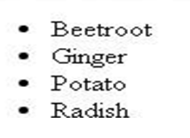
Tags in HTML – Lists (Unordered lists)
LISTS
Unordered Lists :
An unordered list is a collection of related items that have no special order or sequence.
This list is created by using HTML <ul> tag.
Each item in the list is marked with a bullet.
Example
<html>
<head>
<title>HTML Unordered List</title>
</head>
<body>
<ul> <li>Beetroot</li>
<li>Ginger</li>
<li>Potato</li>
<li>Radish</li>
</ul>
</body>
</html>

Slide 27
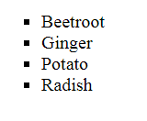
Tags in HTML – Lists
Tags in HTML – Lists (Unordered lists)
UNORDERD LISTS WITH “TYPE” ATTRIBUTE
The type Attribute
we can use type attribute for <ul> tag to specify the type of bullet we like. By default, it is a disc.
Following are the possible options −
<ul type = "square"> <ul type = "disc"> <ul type = "circle">
Example
<html>
<head> <title>HTML Unordered List</title> </head>
<body>
<ul type = "square">
<li>Beetroot</li>
<li>Ginger</li>
<li>Potato</li>
<li>Radish</li>
</ul>
</body>
</html>

Slide 28
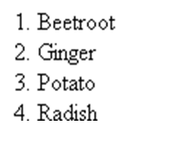
Tags in HTML – Lists (Ordered lists)
ORDERED LISTS
Ordered Lists:-
Items are numbered list instead of bulleted, This list is created by using <ol> tag.
The numbering starts at one and is incremented by one for each successive ordered list element tagged with <li>.
Example
<!DOCTYPE html>
<html>
<head>
<title>HTML Ordered List</title>
</head>
<body>
<ol>
<li>Beetroot</li>
<li>Ginger</li>
<li>Potato</li>
<li>Radish</li>
</ol>
</body>
</html>

Slide 29
Tags in HTML – Lists (Ordered lists)
ORDERED LISTS WITH TYPE ATTRIBURE
The type Attribute:
we can use type attribute for <ol> tag to specify the type of numbering we like. By default, it is a number. Following are the possible options.
<ol type = "1"> - Default-Case Numerals.
<ol type = "I"> - Upper-Case Numerals.
<ol type = "i"> - Lower-Case Numerals.
<ol type = "A"> - Upper-Case Letters.
<ol type = "a"> - Lower-Case Letters.
<html>
<head> <title>HTML Ordered List</title> </head> <body>
<ol type = "1">
<li>Beetroot</li>
<li>Ginger</li>
<li>Potato</li>
<li>Radish</li>
</ol>
</body>
</html>

Slide 30
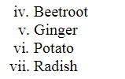
Tags in HTML – Lists (Ordered lists)
ORDERED LISTS WITH “START” ATTRIBURE
The start Attribute
we can use start attribute for <ol> tag to specify the starting point of numbering we need. Following are the possible options −
<ol type = "1" start = "4"> - Numerals starts with 4.
<ol type = "I" start = "4"> - Numerals starts with IV.
<ol type = "i" start = "4"> - Numerals starts with iv.
<ol type = "a" start = "4"> - Letters starts with d.
<ol type = "A" start = "4"> - Letters starts with D.
<html>
<head> <title>HTML Ordered List</title> </head>
<body>
<ol type = "i" start = "4">
<li>Beetroot</li>
<li>Ginger</li>
<li>Potato</li>
<li>Radish</li>
</ol>
</body>
</html>

Slide 31
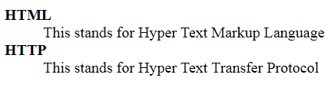
Tags in HTML – Lists (Definition lists)
DEFINITION LISTS
Definition Lists:
HTML supports a list style which is called definition lists where entries are listed like in a dictionary or encyclopedia.
The definition list is the ideal way to present a glossary, list of terms, or other name/value list.
Definition List makes use of following three tags.
1). <dl> - Defines the start of the list
</dl> - Defines the end of the list
2). <dt> - A term
. <dd> - Term definition
<html>
<head>
<title>HTML Definition List</title>
</head>
<body>
<dl>
<dt>HTML</dt>
<dd>This stands for Hyper Text Markup Language</dd>
<dt>HTTP</dt>
<dd>This stands for Hyper Text Transfer Protocol</dd>
</dl>
</body>
</html>

Slide 32
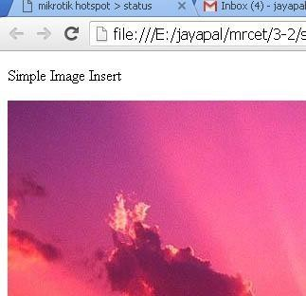
Tags in HTML – Image tag
IMAGES
<img> tag The HTML <img> tag is used to embed an image in a web page.
Closing tags are not used in HTML image element.
The <img> tag has two required attributes:
src - Specifies the path to the image
alt - Specifies an alternate text for the image
Insert Image :
we can insert any image in web page by using <img> tag.
Syntax:
<img src = "Image URL" attributes-list>
Ex.:
<img src="C:\Users\Pictures\flowe.jpeg" alt=“A pixabay flower">

Slide 33

Tags in HTML – Image tag (Size)
IMAGES:
Set Image Width/Height
<img src = "/html/images/test.png" alt = "Test Image" width = "150" height = "100"/>
<html>
<body>
<h2>Image Size</h2>
<img src=“flower.jpg" alt=“A Pixabay flower” width="500" height="600">
</body>
</html>

Slide 34
Tags in HTML – Image tag (Alignment)
IMAGES
IMAGE ALIGNMENT
The align attribute specifies the horizontal and vertical alignment of the image in relation to the surrounding text/elements.
Example
<img src = "test.png" alt = "Test Image"align = "right"/>
Value | Description
left | Align the image to the left
right | Align the image to the right
top | Align the image on the top
bottom | Align the image on the bottom
Middle | Align the image on the middle

Slide 35
Tags in HTML – Image tag (Borders)
IMAGES:
SET IMAGE BORDER:
The <img> border attribute is used to specify the border width around the image.
The default value of <img> border attribute is 0.
It is not supported by HTML 5. Use CSS instead of this attribute
<img src = "test.png" alt = "Test Image" border = "3"/>

Slide 36
Tags in HTML – Anchor tag
Anchor tag <a>
The HTML anchor tag defines a hyperlink that links one page to another page.
It can create hyperlink to other web page as well as files, location, or any URL.
syntax
<a href = “url"> Link Text </a>
Ex:
<a href = “www.goolge.com"> Click Here </a>
<a href = “home.html"> Home page</a>

Slide 37
Tags in HTML – Anchor tag example
Program to create a Hyperlink
<!DOCTYPE html>
<html>
<head>
<title></title>
</head>
<body>
Click on <a href="https://www.chitkara.edu.in/" target="_blank"> this-link </a>to go on home page of Chitkara University.
</body>
</html>

